Slide 1
Smart Waiter Demonstration

Slide 2
Outline
Problem Statement
Smart Waiter Demo
App components
Database
Select and Customize item
Placing an Order
User-Friendliness
Portability/Extensibility
Conclusion

Slide 3
Problem Statement
Lack of singular solution to allow users to walk into a restaurant and place an order via smart phone
Smart-waiter:
Scan barcode to view menu
Select and customize menu item
Place an order

Slide 4
Smart-Waiter App Demo

Slide 5
Database

Slide 6
Select and Customize Item

Slide 7
Transaction

Slide 8
User Friendliness
Concentrated on User Interface
Conducted second Usability Test
6 participants
Experienced an inexperienced with apps
Task – Full walkthrough of application

Slide 9
Usability Test Results
Case | Test #1 | Test #2
Complete task quickly? | Neutral | Agree
Easy to learn | Agree | Agree
Prefer using Smart-Waiter over traditional menu | Agree | Agree
Interface of system is pleasant | Disagree | Agree/Strongly Agree
System has all functionalities and capabilities | Disagree | Disagree
I could recover easily and quickly | Agree | Agree
Overall, I was happy with the system | Agree | Agree

Slide 10
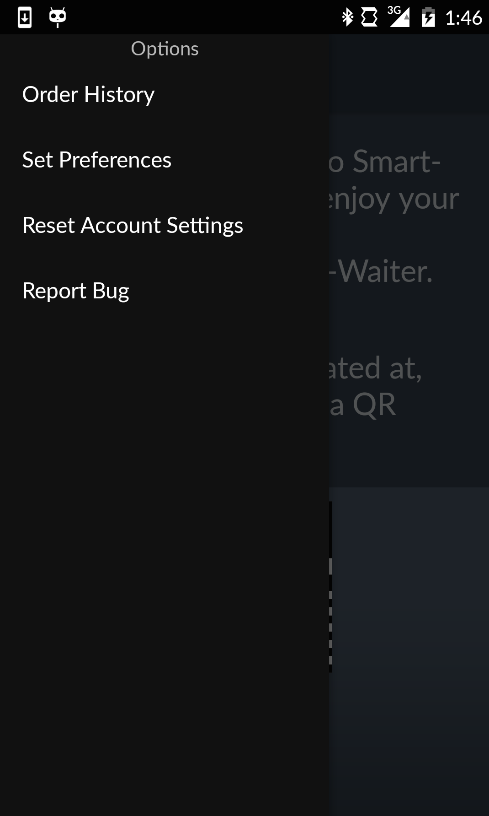
Portability/Extensibility
User Class Integral component
Customized items
Account information
Past orders

Slide 11
Conclusion

